Slide 1


Review to Feature Mapping
NLP Project
TEAM ENIGMA
Ramya Mamidipaka
Mansi Rathi
Moushumi Bhattacharya Jaikumar Ambekar
Notes:
Hello Everyone. GE. This is team Enigma. Our NLP project topic is review to feature mapping. Our team comprises of ...

Slide 2

AGENDA
Problem Statement
Proposed Solution
Dataset Information
Implementation
Demo
Potential Applications
Notes:
We will walk you through first the problem statement. The problem statement shows what problem the organization wants to cater to. We then try to detail out a theoretical solution that we propose. To work on the problem statement we researched various datasets to finally select one. We will talk about that dataset and then move to the implementation supported by some demo slides that show various code snippets from our implementation. We will end with some potential use cases or applications of our solution.

Slide 3

PROBLEM STATEMENT
Review analysis to identify the needs and frustrations of customers, so that businesses can improve customer satisfaction and reduce churn by analyzing the threshold customer feature ratings.
Notes:
Most users provide reviews for various smartphones they purchase which has a serious impact of its brand perception. A smartphone company wants to identify the needs and frustrations of the customers based on a certain rating threshold of different smartphone features and improve customer satisfaction.

Slide 4
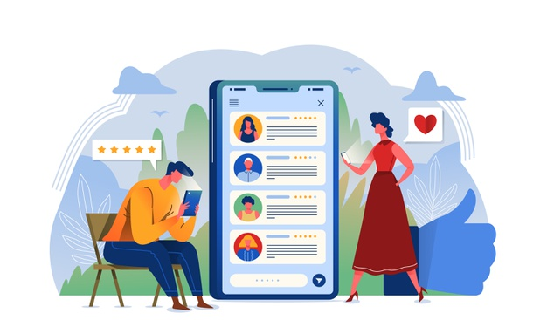
WHY CUSTOMER REVIEWS ?
Reviews not only have the power to influence consumer decisions but can strengthen a company’s credibility. Reviews have the power to gain customer trust, and they encourage people to interact with the company. Customer interaction ultimately leads to improved profits for businesses.
In the U.S, 68% of online shoppers are more likely to engage with businesses that have positive reviews, and 93% determine whether a business has a good reputation (or not) based upon the available reviews.
Notes:
Reviews help to build trust and credibility for the products and set standards for online and offline shoppers. Based on reviews and ratings, all customers define their perception of a brand and the organization. In the U.S, 68% of online shoppers are more likely to engage with businesses that have positive reviews, and 93% determine whether a business has a good reputation (or not) based upon the available reviews. Therefore positive reviews tend to attract more customers and improve bottomline for the business.

Slide 5

PROPOSED SOLUTION
Bucket the reviews of a product according to the product feature (here product is a smart phone)
Analyse sentiment on each bucket of reviews
Compare the ratings for different mobile phones and take necessary actions for the next incoming product
Notes:
To solve this problem, we will be grouping reviews based on product feature mentioned in those reviews into different buckets. Then we go on analyse sentiment of every bucket of reviews. We can then compare ratings of different mobile phones and take the corrective actions.

Slide 6
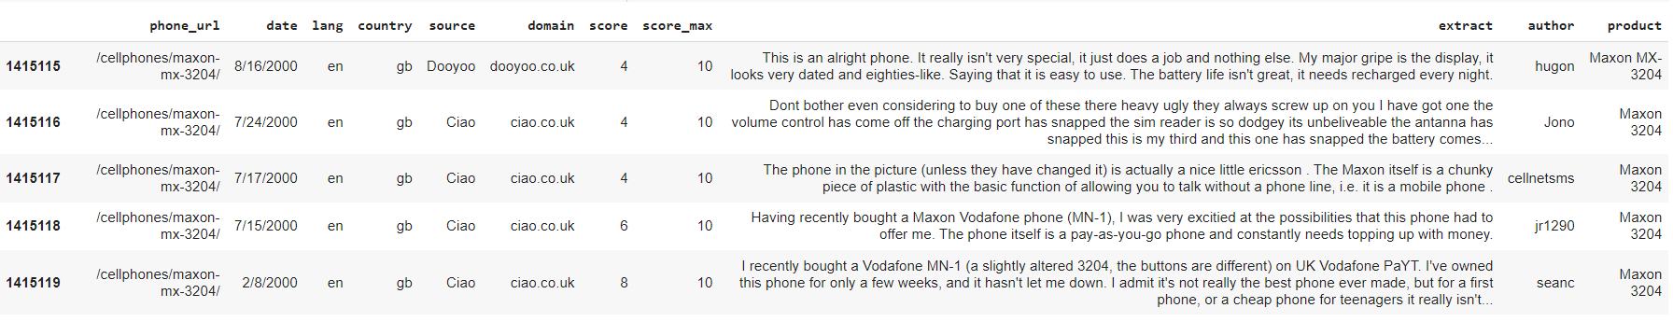
DATASET
Dataset is huge csv file with around 1.4 million reviews for different phone brands (i.e apple, Samsung, pixel etc ) from various countries.
Filtered the reviews on relatively recent product from USA ( ex: iphone 10) to get around 25000 reviews
Use date, extract (review) and product fields of the data set
Source: https://www.kaggle.com/masaladata/14-million-cell-phone-reviews
Notes:
We picked 1.4m reviews dataset from Kaggle with phone reviews of different companies like apple, samsung etc. We filtered them on US reviews and reviews collected after 2015 to get approximately 25000 reviews of new phones in the market the dataset has details like date, language, rating score, review, author name and product name. we will be restricting to date, review and product field of the dataset.

Slide 7
IMPLEMENTATION
POS Tagging & Cleaning
Clustering Vectors
Similarity & Feature Mapping
Sentiment Analysis
Break the reviews
Collect all “NOUNS”
Extract all the features from the reviews
Find most “Talked” about features of the smartphones
Vectorize the feature and nouns extracted
Get similarity index
Bucket the review to the most similar feature
Detect sentiments
Notes:
The complete implementation is divided into 4 steps.
Reviews can have multiple sentences. So we start with breaking the reviews in sep sentences. After splitting we go on to POS tagging them to collect all the “NOUNS”
To extract all the features from the reviews, we import word vectors and then cluster the vectors of the nouns extracted from the reviews. After visually inspecting the clusters we try and find the most “Talked” about features of the smartphones and create our own curated list of features to help in mapping the review to features.
After Getting the features, Using the word embeddings, we vectorised the features and Nouns extracted. After Vectorising, we used cosine similarity to get the similarity index of a feature to a review. The strongest cosine similarity determines the feature bucket for the review.
Therefore we go on to Bucketing the reviews to the most similar feature, and used comprehend to detect sentiments for the reviews

Slide 8
DEMO
1. Break the reviews into separate sentences
Phone performance is better than the last apple version. I really liked the camera and the pictures are just amazing
Its been so easy for me to carry on this phone, I don’t need to charge for so long. But the 16gb space is too less for todays phones, I need it more than 32 gb atleast

Slide 9
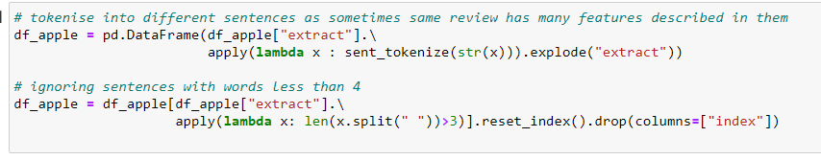
DEMO
1. Break the reviews into each sentence
Phone performance works better than the last apple version.
I really liked the camera and the pictures are just amazing
Its been so easy for me to carry on this phone, I don’t need to charge for so long.
But the 16gb space is too less for todays phones, I need it more than 32 gb atleast

Slide 10
DEMO
2. Cleaning the Text
Phone performance works better than the last apple version.
I really liked the camera and the pictures are just amazing
Its been so easy for me to carry on this phone, I don’t need to charge for so long.
But the 16gb space is too less for todays phones, I need it more than 32 gb atleast

Slide 11
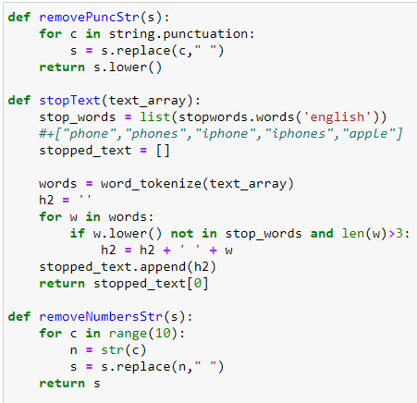
DEMO
2. Cleaning the Text
Phone performance works better than the last apple version.
I really liked the camera and the pictures are just amazing
Its been so easy for me to carry on this phone, I don’t need to charge for so long.
But the 16gb space is too less for todays phones, I need it more than 32 gb atleast

Slide 12
DEMO
3. POS Tagging AWS Comprehend
Phone performance works better last apple version
really camera pictures just amazing
easy carry phone need charge long
less todays phones space more gb atleast

Slide 13
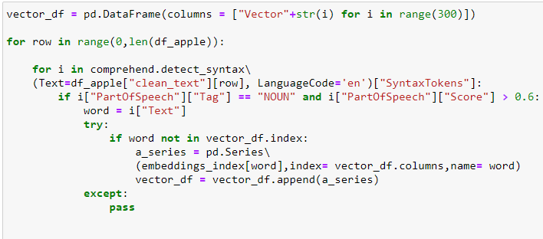
DEMO
3. POS Tagging AWS Comprehend
Phone performance works better last apple version
really camera pictures just amazing
easy carry phone need charge long
16gb less todays phones space more 32 gb atleast

Slide 14
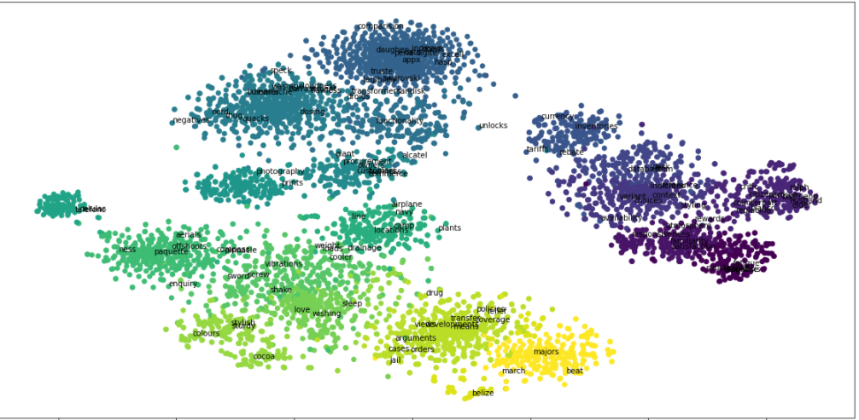
DEMO
4. Cluster the highlighted Glove word embeddings 300D from all the reviews

Slide 15
DEMO
4. Cluster the highlighted Glove word embeddings 300D from all the reviews
From these clusters upon visual inspection, got the below Features
Features = ["Performance","Display","Battery","Camera","Design","Storage","Audio","Cost", "style“, "accessories", ”size", "software"]

Slide 16
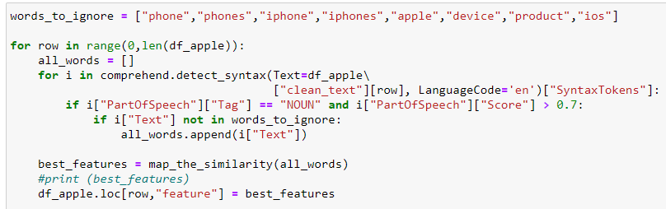
DEMO
5. Bucket the review into the Feature
Word to compare:
charge
easy carry phone need charge long

Slide 17
DEMO
5. Bucket the review into the Feature
Performance 0.24
Display 0.32
Battery 0.49
Camera 0.34
Design 0.29
Storage 0.33
Audio 0.39
easy carry phone need charge long
Charge
Cosine
Similarity
with embeddings

Slide 18
DEMO
5. Bucket the review into the Feature
Review | Feature Bucket
Phone performance works better last apple version | Performance
really camera pictures just amazing | Camera
easy carry phone need charge long | Battery
16gb less todays phones space more 32 gb atleast | Storage

Slide 19
DEMO
6. Sentiment Scoring
Review | Feature Bucket | Sentiment
Phone performance works better last apple version | Performance | 0.78
really camera pictures just amazing | Camera | 0.88
easy carry phone need charge long | Battery | 0.79
16gb less todays phones space more 32 gb atleast | Storage | -0.09

Slide 20
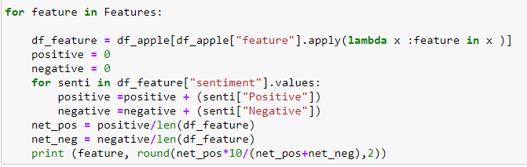
DEMO
6. Sentiment Scoring for all features
Feature Bucket | Iphone 9 | Samsung S20
Performance | 7.5 | 7.9
Camera | 6 | 7.3
Style | 7.7 | 8
Storage | 5 | 5.5
Design | 7 | 7
Battery | 6 | 6.2
Accessories | 6.5 | 6
Size | 7.7 | 7
Software | 7.7 | 6.5

Slide 21
POTENTIAL APPLICATION
Audience Targeting:
Know your audience who is purchasing your product, what demographic they have, to deploy more specific strategies in future.
Shopper behaviour:
Evaluate shopping behaviour for customers, which feature of the product is having maximum impact or is having crucial in decision making for customer.
Feature Improvement:
Analyze pain point or poorly performing features for the product, due which we are losing out on potential customers base.
Market basket Analysis:
Compare the core functionality with top competitors in market
Notes:
Know your audience who is purchasing your product, what demographic they have, to deploy more specific strategies in future

Slide 22

QUESTION AND FEEDBACK?

